Slide 2
Deploying WebLogic Applications on Kubernetes
Monica Riccelli – Product Manager
Ryan Eberhard - Architect

Slide 4

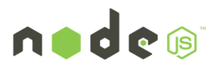






WebLogic, Coherence and Cloud Native Trends
Industry trends
Microservices, serverless
Private and public clouds
Containers, orchestration frameworks
WebLogic, Coherence customer demand
Leverage cloud neutral infrastructure
Integrate with new tools and services
Evolve WebLogic, Coherence for these environments
Blockchain
WebLogic
Coherence

Slide 5

Oracle Enterprise Java Strategy Evolve Products to Meet Customer Demand
Operator
Migrate to Kubernetes on premise
Tools for migration and management
Support existing and new applications
Migrate to Kubernetes on Oracle Cloud
Leverage management tools on OCI
Availability, security, scaling, low-cost
Integrate with Microservices
Flexibility for developers
Evolve and manage applications
WebLogic
Coherence
Oracle Cloud and Other Clouds
Migrate
Operator
WebLogic
Coherence
WebLogic
Coherence
Physical & VMs On Premise
Kubernetes on Premise

Slide 6


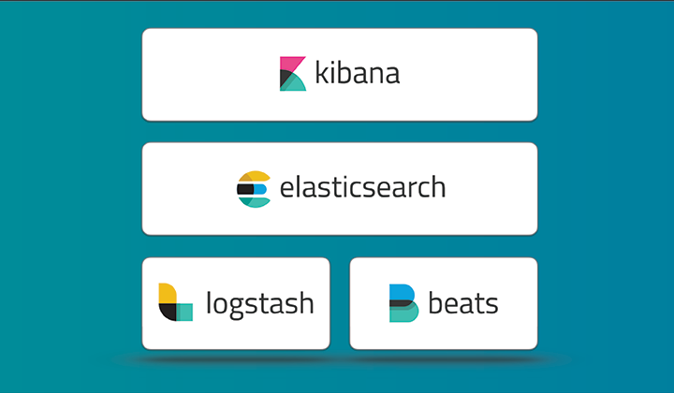
WebLogic Server on Kubernetes - Building Blocks
Operator
Docker and CRI-O certification
Docker images, Dockerfiles, examples
WebLogic Kubernetes certification
How-to, best practices
Value add integration
Management: Operator
Monitoring: Exporter for Prometheus
Migration: Deploy tooling
Logging: Exporter for Elastic Stack
Image Creation: WebLogic Image Tool
WebLogic
Coherence

Slide 7
WebLogic Domain in Kubernetes Domain Custom Resource
We create a Kubernetes Resource Object for the WebLogic domain.
This is a data structure representation of the WebLogic domain in Kubernetes.
Domain Custom Resource allows you to declare or specify the desired state of the resource.
Allows the Kubernetes API server to begin serving the custom resource object.
The WebLogic Kubernetes Operator is a controller that is always looking at the Domain Custom Resource and tries to match the actual state to this desired state.
Domain Custom Resource
Meta Data: Name of Resource, Namespace, Labels, …
Admin Server: Node Ports to expose, Volumes, …
Cluster: Number of Replicas (Managed Servers), …
Domain: Image to base the Domain containers, Domain in PV or in Image, K8S secrets, Logs to pod
Managed Servers: non-clustered MS
Server Pod: Java Options, Start Policy (Lifecycle control)
Events:

Slide 8
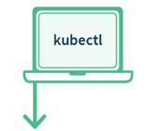



Why build the WebLogic Kubernetes Operator?
Contains built-in knowledge about how to perform lifecycle operations on a domain
Uses Kubernetes APIs to automate lifecycle operations.
Operator
Kubernetes
Orchestrate WebLogic
Manage
Pods
WLS Cluster
POD 1
POD 2
POD 3
POD 4
POD 5
POD 6
AS
MS
MS
MS
MS
MS
Kubernetes Cluster
Notes:
Operator is an application-specific controller that extends Kubernetes to create, configure, and manage instances of complex applications. The WebLogic Kubernetes Operator follows the standard Kubernetes Operator pattern,
Some of the things that the Operator does to simplify management and operations on the WebLogic domain and deployments
Create RBAC roles to manage Kubernetes resources on behalf of the WebLogic domain. Authorization to start/stop/.restart/create new domain.
Invokes the right Kubernetes APIs to start or stop servers, domains, clusters
the WebLogic Diagnostic framework Auto-scale setting rules in when the rule is met the Operator will invoke K8S API to scale the WebLogic cluster
When there is a new patched WebLogic image or a Application update initiate a rolling restart of the WebLogic domain

Slide 9
WebLogic Kubernetes Operator
1
2
3
Manages lifecycle operations (start, stop, scale, rolling restart, etc.) in Kubernetes
Automate configuration, e.g. clustering, channels/ports, configuration overrides
Supports standard k8s idioms like sidecars, init containers, custom resources
Open source and fully supported https://github.com/oracle/weblogic-kubernetes-operator

Slide 10
Deploy WebLogic Server in Kubernetes

Slide 11

WebLogic Server Domain in Kubernetes
Customer Tenancy
Repository
WLS Domain Image
Operator
Image
Kubernetes
Domain CR
Kubernetes Cluster
Secrets
WebLogic Domain Image
WebLogic binaries
Domain
Applications
Operator
WebLogic Domain(s)
WLS Cluster
POD 1
POD 2
POD 3
POD 4
POD 5
POD 6
AS
MS
MS
MS
MS
MS
Logs

Slide 12


WebLogic Domain in Kubernetes Operator Domain Home in Image
Customer Tenancy
Repository
WLS Domain Image
Operator
Image
Kubernetes
Kubernetes Cluster
Kubernetes

Slide 13
Customer Tenancy
Repository
WLS Domain Image
Operator
Image
Kubernetes
Kubernetes Cluster
Secrets
Kubernetes

Slide 14

Customer Tenancy
Repository
WLS Domain Image
Operator
Image
Kubernetes
Kubernetes Cluster
Secrets
Operator
Kubernetes

Slide 15
Customer Tenancy
Repository
WLS Domain Image
Operator
Image
Kubernetes
Kubernetes Cluster
Secrets
Operator
Kubernetes

Slide 16
Customer Tenancy
Repository
WLS Domain Image
Operator
Image
Kubernetes
Kubernetes Cluster
Secrets
Operator
Kubernetes

Slide 17
Customer Tenancy
Repository
WLS Domain Image
Operator
Image
Kubernetes
Kubernetes Cluster
Secrets
Operator
Install Domain inputs (yaml)
Kubernetes

Slide 18
Customer Tenancy
Repository
WLS Domain Image
Operator
Image
Kubernetes
Domain CR
Kubernetes Cluster
Secrets
Operator
Install Domain inputs (yaml)
kubectl apply …
Kubernetes

Slide 19
Customer Tenancy
Repository
WLS Domain Image
Operator
Image
Kubernetes
Domain CR
Kubernetes Cluster
Secrets
Operator
WebLogic Domain(s)
WLS Cluster
POD 1
POD 2
POD 3
POD 4
POD 5
POD 6
AS
MS
MS
MS
MS
MS
Kubernetes
Logs

Slide 20
WebLogic Server Domain in Kubernetes
Customer Tenancy
Repository
WLS Binary Image
Operator
Image
Kubernetes
Domain CR
Kubernetes Cluster
Secrets
WebLogic install Image
WebLogic binaries
PV
Domain
Applications
Operator
WebLogic Domain(s)
WLS Cluster
POD 1
POD 2
POD 3
POD 4
POD 5
POD 6
AS
MS
MS
MS
MS
MS
Logs
Domain
Application

Slide 21
Which model should I use?
The key difference is how updates are handled
Java updates
WebLogic patching
WebLogic configuration changes
Application updates
Are you fully embracing the CI/CD "DevOps" model and intend to manage change through that process?
E.g. create new images every time there is an update.
Are you making changes to configurations and deployments in running systems?
E.g. run WLST online to dynamically change your domain configuration.

Slide 22
Configuration Overrides

Slide 23
Configuration Overrides
WebLogic Images containing Application, domain configuration, resources are immutable.
These Docker images must be portable
Development -> Testing -> Production.
Follow the customer’s CI/CD process.
Therefore, customers need a mechanism to override certain domain configuration
E.g. Provide data source URL and credentials

Slide 24
Domain Introspection and Config Override Generation
Introspection Job
WLS Domain Image
Domain
Customer provided override templates
Scan domain configuration for topology and to validate
Generation of final configuration overrides
Operator
Operator overrides

Slide 25
User Configuration Overrides
Typical attributes for overrides include:
User names, passwords, and URLs for:
JDBC datasources
JMS bridges, foreign servers, and SAF
Network channel public addresses:
For remote RMI clients (T3, JMS, EJB, JTA)
For remote WLST clients
Debugging
Tuning (MaxMessageSize, etc.)

Slide 26
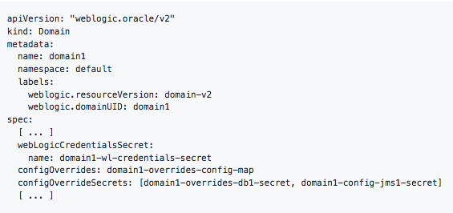
Configuration Overrides
Create a Kubernetes configuration map that contains:
Override templates
Create Kubernetes secrets that contains:
Data source username and password.
Set your domain CR
Config map.
Secret with the Config Override
Start or restart your domain.

Slide 27
Life Cycle Operations

Slide 28
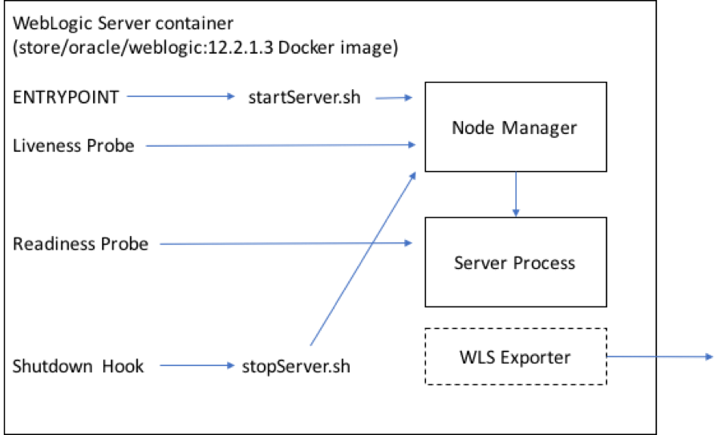
WebLogic Operator Lifecyle Management
ENTRYPOINT – start WebLogic Server
Liveliness probe – check if the the WebLogic server is alive
Readiness probe – query if the WebLogic server is ready to receive requests
Shutdown Hook – gracefully shutdown the WebLogic server

Slide 29
WebLogic Lifecyle Management
The operator automatically recreates server pods when :
Changes to the domain CR that affect server pods (image, volumes, and env).
A user can control lifecycle of the WebLogic domain/cluster/server by editing Domain Custom Resource
Start/stop/re-start
initiate a rolling-restart of the domain.
The Operator reacts and performs the correct lifecycle operation.
Stop Clustered Manage Server 1
Domain Custom Resource
Edit Domain CR
domain:
spec:
managedServers:
- serverName: "cluster1_server1”
serverStartPolicy: ”NEVER" ...

Slide 30
Demo

Slide 31
Assigning Pods to Nodes

Slide 32
Assigning WebLogic Pods to Nodes
Use Node Selector to constrain a pod to only be able to run on particular nodes.
Assign a label (key=value)to the node:
kubectl label nodes kubernetes-foo-node-1 licensed-for-weblogic=true
Edit the Domain Custom Resource at the domain/cluster/server level and assign key:value nodeSelector.
Domain Custom Resource
Edit Domain CR
serverPod:
nodeSelector:
licensed-for-weblogic: true

Slide 33
Assigning WebLogic Pods to Nodes
Assign pods to Nodes based on resources, e.g. CPU and Memory usage
A Pod is scheduled to run on a Node only if the Node has enough CPU resources available.
Domain Custom Resource
Edit Domain CR
serverPod:
resources:
requests:
memory: "8Gb"
cpu: "250m"
limits:
memory: "128Mi"
cpu: "500m"`

Slide 34
Inter-Pod Affinity and Anti-Affinity
Which K8s nodes to schedule or re-schedule pods with respect to other WebLogic pods
Possible types of Node affinity/anti-affinity:
Preferred (soft affinity)
Required (hard affinity)
Match labels for Affinity/Anti-affinity
Operator: In
Operator: Exists
Operator: NotIn
Operator: DoesNotExist
Edit Domain CR
serverPod:
affinity: podAntiAffinity:
preferredDuringSchedulingIgnoredDuringExecution:
- labelSelector:
matchExpressions:
- key: "weblogic.clusterName"
operator: In
values: - cluster-1
topologyKey: "kubernetes.io/hostname"

Slide 35
WLS POD2
Operator
Schedule
Node 1
Node 2
Node 3
WLS POD1
weblogic.clusterName
Licensed-for-weblogic
Licensed-for-weblogic
nodeSelector:
licensed-for-weblogic: true
affinity: podAntiAffinity:
preferredDuringSchedulingIgnoredDuringExecution:
- labelSelector:
matchExpressions:
- key: "weblogic.clusterName"
operator: In

Slide 36
Operator
Node 1
Node 2
Node 3
WLS POD1
WLS POD2
weblogic.clusterName
weblogic.clusterName
Licensed-for-weblogic
Licensed-for-weblogic
nodeSelector:
licensed-for-weblogic: true
affinity: podAntiAffinity:
preferredDuringSchedulingIgnoredDuringExecution:
- labelSelector:
matchExpressions:
- key: "weblogic.clusterName"
operator: In

Slide 37
WLS POD3
Operator
Schedule
Node 1
Node 2
Node 3
WLS POD1
WLS POD2
weblogic.clusterName
weblogic.clusterName
Licensed-for-weblogic
Licensed-for-weblogic
nodeSelector:
licensed-for-weblogic: true
affinity: podAntiAffinity:
preferredDuringSchedulingIgnoredDuringExecution:
- labelSelector:
matchExpressions:
- key: "weblogic.clusterName"
operator: In

Slide 38
Operator
Node 1
Node 2
Node 3
WLS POD1
WLS POD3
WLS POD2
weblogic.clusterName
weblogic.clusterName
weblogic.clusterName
Licensed-for-weblogic
Licensed-for-weblogic
nodeSelector:
licensed-for-weblogic: true
affinity: podAntiAffinity:
preferredDuringSchedulingIgnoredDuringExecution:
- labelSelector:
matchExpressions:
- key: "weblogic.clusterName"
operator: In

Slide 39
HA and DR in Kubernetes

Slide 40




WebLogic High Availability
AD 1
AD 2
AD 3
WebLogic High Availability across Data Centers with WebLogic Stretch Clusters.
Span a WebLogic domain across several Availability Domains
Single Kubernetes Cluster
WebLogic domain

Slide 41
WebLogic Disaster Recovery
Region A
WLS Domain image
Region B
WebLogic DR across Regions made easier
WebLogic domain image contains complete domain configuration
State needs to be externalized to Database

Slide 42
Init Containers and Sidecar Containers

Slide 43
Init Containers
Customer Tenancy
Repository
Init containers run in the same pod as the WebLogic servers.
Init containers can be used to perform some initialization action before the server is started.
Example: Change permissions in PV before the domain home is persisted.
WLS Domain Image
Operator
Image
Kubernetes
Domain CR
Kubernetes Cluster
Secrets
Operator
WebLogic Domain(s)
POD 1
WLS Cluster
POD 2
POD 3
POD 4
POD 5
POD 6
Init
MS
Init
MS
Init
MS
MS
MS
Init
AS
MS
Change permissions of directory
Logs
Domain Home
Apps

Slide 44
Sidecar Containers
Customer Tenancy
Repository
WLS Domain Image
Sidecar containers run in the same pod as the WebLogic servers
Sidecar containers can be used to run some process aside the server.
Example: Run Logstash or Fluentd in Sidecar to send logs to the Elastic Stack or to Fluentd.
Operator
Image
Kubernetes
Domain CR
Secrets
Operator
WebLogic Domain(s)
POD 1
WLS Cluster
POD 2
POD 3
POD 4
POD 5
POD 6
AS
SC
MS
SC
MS
SC
MS
MS
MS
SC
MS
Logs

Slide 45
Variable Replacement in Server Pods

Slide 46
Variable Replacement in Server Pods
Customer Tenancy
Repository
Allow to define properties on individual server pods.
e.g. their own volume
WLS Domain Image
Operator
Image
Kubernetes
Domain CR
Kubernetes Cluster
Secrets
Operator
Domain CR
serverPod:
volumes:
- name: $(SERVER_NAME)-volume
emptyDir: {}
volumeMounts:
- mountPath: /server-volume
name: $(SERVER_NAME)-volume
WebLogic Domain(s)
POD 1
WLS Cluster
POD 2
POD 3
POD 4
POD 5
POD 6
AS
MS
MS
MS
MS
MS
MS
Logs
Logs
Logs

Slide 47
WebLogic Logging

Slide 48
WebLogic Logging
We support different ways of persisting WebLogic server logs:
Persist logs to the PV/C.
Use a sidecar container to run Logstash, FluentD and scrape the logs from the standard out of the POD and send them to Elastic Stack or Fluentd
WebLogic Logging Exporter to send WebLogic server logs directly to the Elastic Stack

Slide 49
Tooling

Slide 50

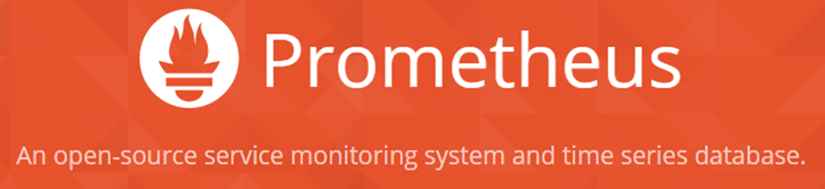
WebLogic Monitoring Exporter
Monitoring Exporter enables Prometheus monitoring of WebLogic
Standard monitoring tools can be used for monitoring WebLogic
Grafana Dashboards used for visualization
Prometheus auto-scaling of WebLogic cluster
Operator
Scale
WLS
Monitor
WebLogic
WebLogic
WebLogic

Slide 51
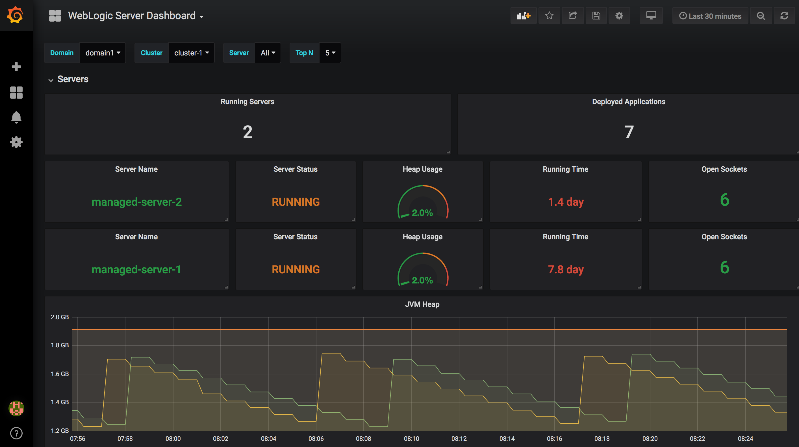
Out of the Box Grafana Dashboards

Slide 52
WebLogic Deploy Tooling
Introspect domains
WebLogic 10.3.6, 12.1.3, 12.2.1.X
Create a model (yaml) of the domain
Migrate existing domains and applications Upgrade (if required) to 12.2.1.X
Supports ADF domain introspection
Customize and Validate configuration to meet Kubernetes requirements.
Create domains in Docker image
Deploy Applications
Modify/remove objects from the Domain configuration
WebLogic Deploy Tooling
Domain Model
WebLogic
WebLogic
WebLogic

Slide 53
WebLogic Logging Exporter
Logging Exporter enables exporting WebLogic server logs to the Elastic Stack
Store logs in the Elastic Stack
Search and analyze logs in Elastichsearch
Display logs in dashboards in Kibana
Kubernetes
Operator
MS
MS
WebLogic
WebLogic
WebLogic

Slide 54
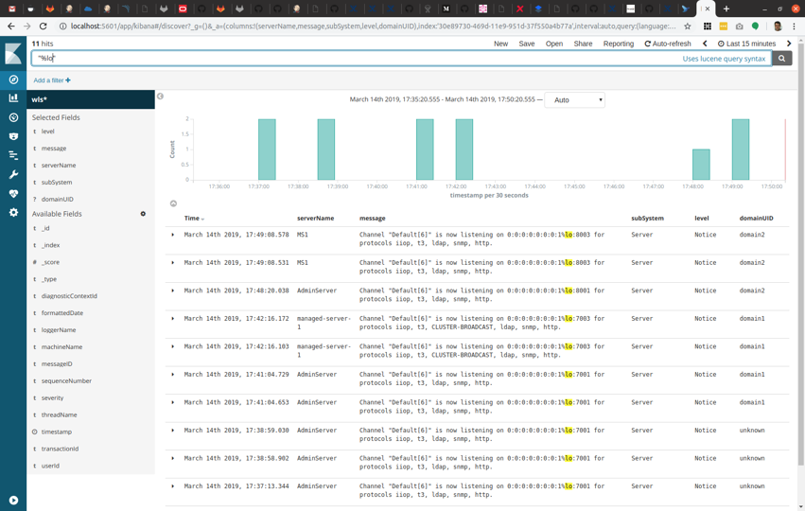
Kibana Dashboards

Slide 55
WebLogic Image Tool
My Oracle Support
Repository
Download
patches
Kubernetes
WLS Image Tool
Use Cases
Operator
Image
MOS Credentials
Patches
Create new image image and Patch
WebLogic binaries
WLS 12.2.1.3 patched Binary Image
Server JRE
Oracle Linux

Slide 56
WebLogic Image Tool
My Oracle Support
Repository
Download
patches
Kubernetes
WLS Image Tool
Use Cases
Operator
Image
MOS Credentials
Patches
WLS 12.2.1.3 patched Binary Image
Update existing image and Patch
WebLogic 12.2.1.3 binary
WLS 12.2.1.3
Binary Image

Slide 57
WebLogic Image Tool
My Oracle Support
Repository
Download
patches
Kubernetes
WLS Image Tool
Use Cases
Operator
Image
MOS Credentials
Create/Update Domain Image with WDT
Domain
WDT model
WLS 12.2.1.3
Domain Image
Patches
WLS 12.2.1.3 Binary Image
WebLogic 12.2.1.3 binary

Slide 58
WebLogic Image Tool
My Oracle Support
Repository
Download
patches
Kubernetes
WLS Image Tool
Use Cases
Operator
Image
WDT model
Update Image and deploy Applications with WDT
Applications
WLS 12.2.1.3
Domain with Applications Image
WebLogic 12.2.1.3 Domain
WLS 12.2.1.3
Domain Image

Slide 59
CI/CD

Slide 60

Automating WebLogic Deployment CI/CD with WebLogic Tooling
Repository
WebLogic domain
image
App v2
WebLogic domain v2
image
WDT model
Pull image
Push Image
Domain
CR
Image Tool & WDT
Operator
Trigger: checkin
Domain.yaml
Roll the domain
Kubectl apply –f domain.yaml
WebLogic Domain
Step1: Update domain image
Step2: Update domain.yaml with new image name
WLS Cluster
POD 1
POD 2
POD 3
MS
Step3: Update Domain CR
AS
MS
MS
MS
MS
GitLab, Jenkins, etc.
Kubernetes Cluster

Slide 61
Automating WebLogic Deployment CI/CD with WebLogic Tooling
Repository
WebLogic binary
image
My Oracle Support
WebLogic domain
image
Invoke Patching
Pull image
Download patches
Pull image
WebLogic
Patched domain image
Push Image
Domain
CR
Image Tool
Operator
Trigger: call to patch
Domain.yaml
Roll the domain
Kubectl apply –f domain.yaml
WebLogic Domain
Step1: Create/Update apply patch and update JDK
Step2: Update domain.yaml with new image name
WLS Cluster
POD 1
POD 2
POD 3
MS
Step3: Update Domain CR
AS
MS
MS
MS
MS
GitLab, Jenkins, etc.
Kubernetes Cluster

Slide 62
Demo

Slide 63
Roadmaps of Open Sourced Tools

Slide 64
WebLogic Kubernetes Operator
>
>
>
2.0
2.X
Future
Future
Second public release of the WebLogic Kubernetes Operator
Domain in Image and PV/PVC
Configuration Overrides
Deploy Operator and Load Balancers with Helm
Support other Load Balancers
Flexibility of WebLogic Server logs persistence
User initiated Lifecycle Management operations
Assign Pods to Nodes
Support of FMW Infrastructure domains (ADF and JRF support)
Configure Init and Sidecar containers
Document CI/CD processes
Support for rolling-restart of a Coherence cluster
Pod templating and additional pod content
Experimental support for running under an Istio service mesh
WDT Model in Image
Certify orchestration of cri-o and kata Containers
Support for running under an Istio service mesh
Support for more FMW products (SOA, OSB, IDM, WebCenter)
Support additional Logging tools – FluentD, Logstash
UI for Operator
Sizing Guide
Support new versions of WebLogic 12.2.1.4, 14.X
Support for the new WebLogic 12.2.1.4 Slim Image
Updated certification OpenShift 4, PCA
Documentation and Samples for more advanced use cases
Notes:
Sizing Guide
Support new WebLogic versions and Slim Image

Slide 65
WebLogic Deploy Tooling
>
>
0. X
1.X
Future
Initial public release of the WebLogic Deploy Tooling (WDT).
Introduced WDT Discover, Create, Update, Validate, and Deploy.
Model filtering allows run-time manipulation of the model prior to create/deploy actions
Support for custom security providers
Support ATP database for RCU
Enable targeting of JRF resources to dynamic clusters
Support user providing for multiple models
Support custom extension templates
Allow discovery of custom security Mbeans.
Add WebLogic Server XACML roles using the model
Set the OPSS password secret
Added support Ubuntu clients
Support for JMS load balancing enhancement.
Add the ability to remove Servers, Datasources, and other named objects.
FMW product support (SOA, OSB, WebCenter, IDM)
Performance Improvements!
Support new WebLogic versions 12.2.1.4, 14.X

Slide 66
WebLogic Image Tool
>
>
1.0
1.x
Future
Initial public release of the WebLogic Image Tool
Configure a WebLogic domain in image
Deploy Applications
Apply WebLogic Server patches
Update JDK or Oracle Linux
Integrate with WebLogic Deploy Tool.
Override OS user and group IDs for file ownership in image.
Support Creating and patching a Fusion Middleware Infrastructure image.
Added Model in Image feature
Deploy Monitoring Exporter
Rebase a domain image
Support for Buildah
Build image from existing domain (discover domain on premise)

Slide 67
WebLogic Monitoring Exporter
>
>
1.0
1.1
Future
Initial public release of the Monitoring Exporter.
Export all WebLogic Server runtime Metrics to Prometheus
Display in Grafana Dash Boards
Support access via load-balancer
Out of the box Grafana Dashboards
Create sample to use Prometheus Alert Manager
Support Application metrics
Operator to deploy Monitoring Exporter
Usability improvements

Slide 68
WebLogic Logging Exporter
>
1.0
Future
Initial release of the Logging Exporter.
Export WebLogic Server logs to the Elasticsearch using REST APIs
Display logs in Kibana
Support additional Logging tools – FluentD, Logstash
Support different log types – applications, access, etc.
Out-of-the box Kibana dashboards for WebLogic server logs.

Slide 69
Fusion Middleware Infrastructure

Slide 70
Fusion Middleware Infrastructure
The Fusion Middleware Infrastructure install images contains:
WebLogic binaries
Coherence binaries
JRF binaries
RCU binaries
FMW Install Image
Fusion Middleware Infrastructure
JRE Image
Server JRE
Oracle Linux
Base Image

Slide 71
Fusion Middleware ADF & JRF Support on Docker
Domain
Fusion Middleware Infrastructure
Server JRE
Fusion Middleware Infrastructure
Oracle Linux
App A
Domain Image
Server JRE
Oracle Linux
RCU
Fusion Middleware Infrastructure
Server JRE
Base Image
OracleFMWInfrastructure 12.2.1.3
Oracle Linux
RCU Image
Sample
12213-domain-in-volume

Slide 72
Fusion Middleware ADF & JRF Support on Docker
Linux Host 1
Linux Host 2
Linux Host 3
Domain
Cluster
RCU
Linux Host 0
MS
MS
LB
FMW Infra Admin Server
App A
MS
MS
Create RCU Schema
Retrieve RCU Schema
DB

Slide 73
Fusion Middleware ADF & JRF Support on Kubernetes
Customer Tenancy
Repository
FMW Infra Domain Image
Operator
Image
Kubernetes
Domain CR
Kubernetes Cluster
Secrets
FMW Infra Domain Image
WebLogic binaries
Domain
Applications
Operator
WebLogic Domain(s)
WLS Cluster
POD 1
POD 2
POD 3
POD 4
POD 5
POD 6
AS
MS
MS
MS
MS
MS
Logs

Slide 74
Fusion Middleware ADF & JRF Support on Kubernetes
Repository
Customer Tenancy
FMW Infra Binary Image
Operator
Image
Kubernetes
Domain CR
Kubernetes Cluster
Secrets
FMW Infrastructure Image
FMW Infrastructure binaries
PV
Domain
Applications
Operator
WebLogic Domain(s)
WLS Cluster
POD 1
POD 2
POD 3
POD 4
POD 5
POD 6
AS
MS
MS
MS
MS
MS
Logs
Domain
ADF Apps

Slide 75
Working with our Customers to migrate their applications to Kubernetes
Workshops – The PM team offers 1 or 2 day workshops to give you hands on experience with WebLogic on Kubernetes and our open source tools. Contact Maciej Gruszka (maciej.gruszka@oracle.com) or Monica Riccelli (monica.riccelli@oracle.com) to schedule one.
Public Slack Channel – You will have direct access to our Architects and Engineers to ask questions, provide requirements, or get help. Register at https://weblogic-slack-inviter.herokuapp.com/.
POC – You will have a dedicated engineer to help you through the POC. We will schedule equal cadence weekly meetings to discuss status, and work through problems. Contact Monica Riccelli (monica.riccelli@oracle.com).

Slide 77
Thank You
Monica Riccelli – Product Manager
Ryan Eberhard– Architect

